Slide 1
Growing Your Vocabulary:
Learning from Latin and Greek Roots
5th grade
Book B

Slide 2
Chapter One – Flower Power
Roots to Learn:
Flor
Foli/foil
dendr
Words to Learn
flourish foil
florist portfolio
florid rhododendron
foliage dendrite
Suffix:
-ist

Slide 3
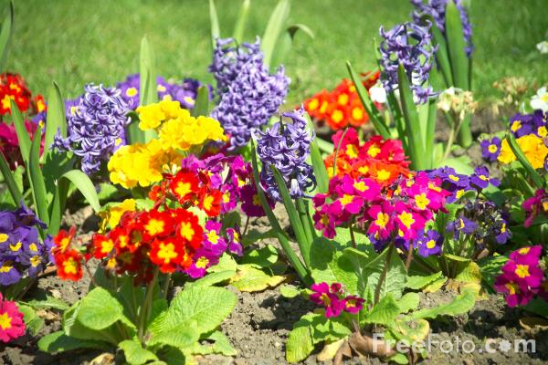

flourish florist

Slide 4
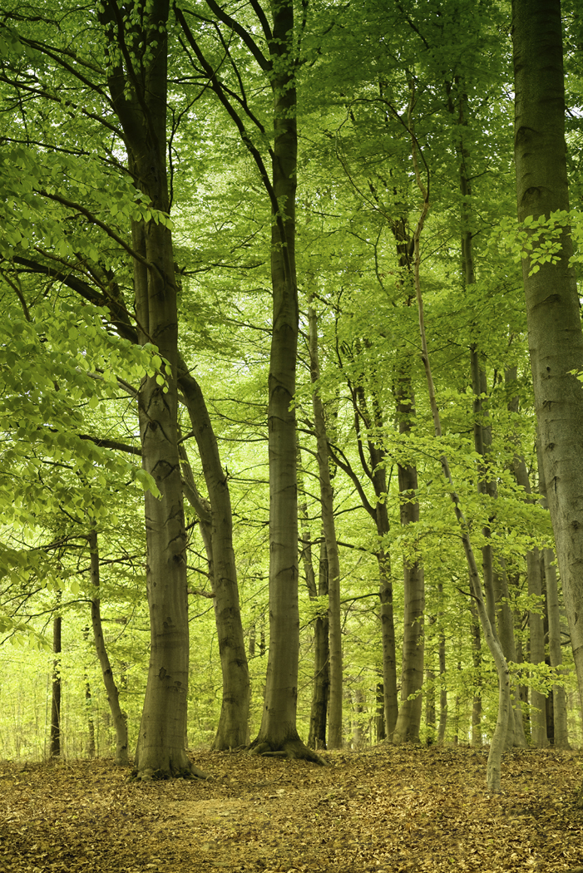
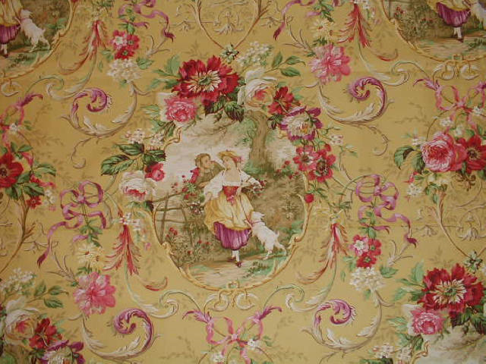
florid foliage

Slide 5
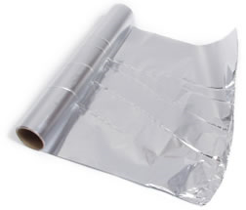
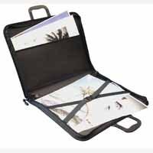
foil portfolio

Slide 6
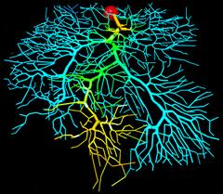
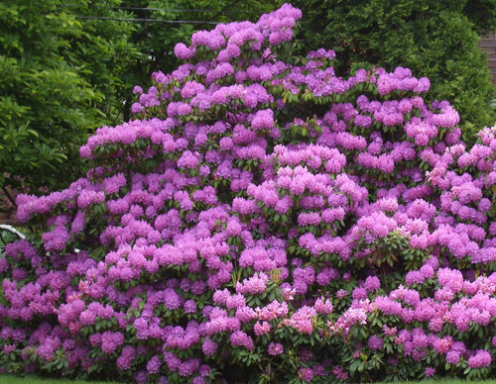
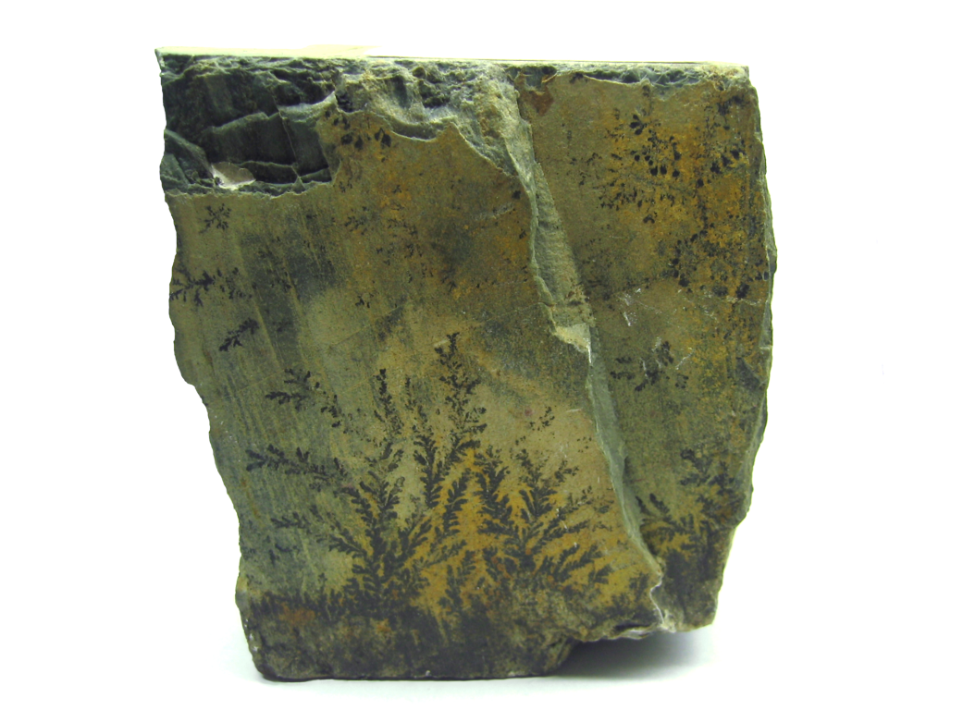
rhododendron dendrite

Slide 7
Chapter Two – All in the Family
Roots to Learn:
mater/matr
pater/patr
frater
Words to Learn
maternal patriotism
matrimony patron
matriarch fraternity
paternity fraternal
patriarch
Suffix:
-ism

Slide 8
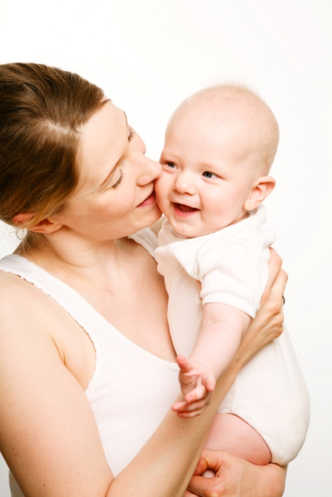
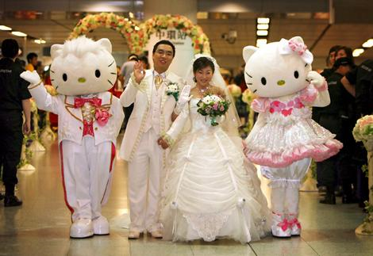
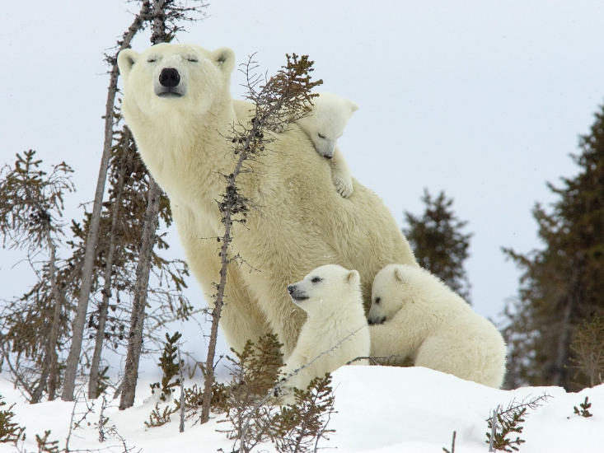
maternal matrimony

Slide 9
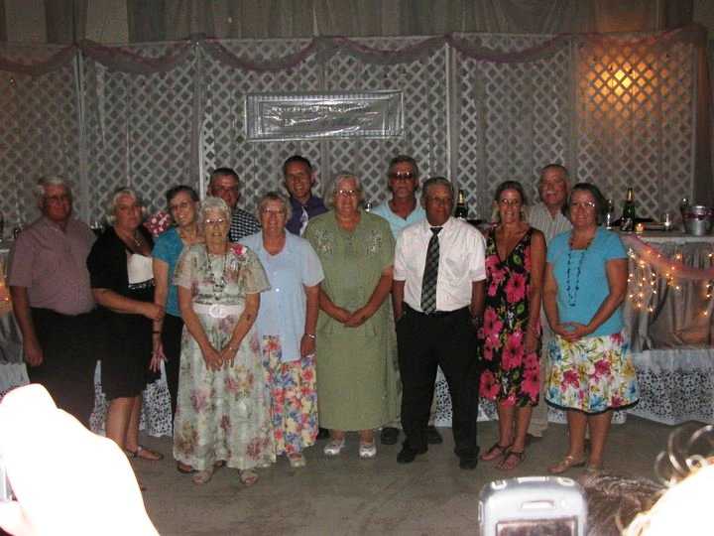
matriarch

Slide 10
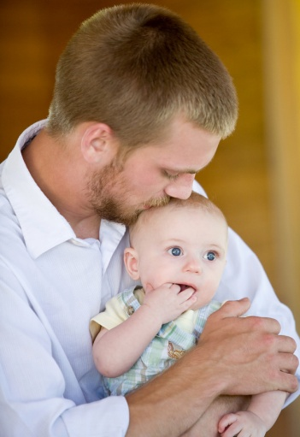
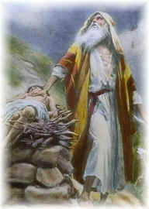
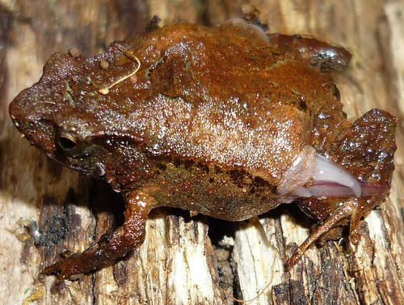
paternity patriarch

Slide 11

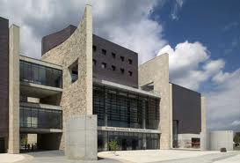

patriotism patron

Slide 12
Chapter Three – Here and There
Roots to Learn:
urb loc
poli
Words to Learn
urban location
suburban relocate
police local
policy locale
political dislocate
metropolis
Prefixes: Suffix:
sub- -tion
dis-

Slide 13
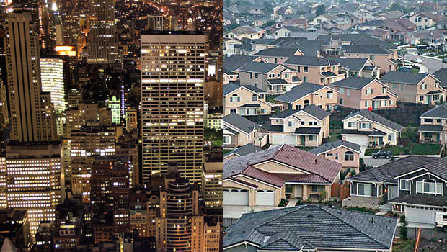
urban suburban

Slide 14
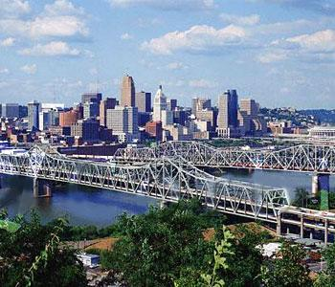
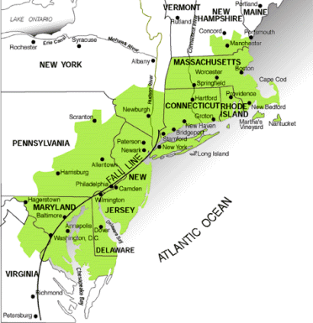
metropolis megalopolis

Slide 15

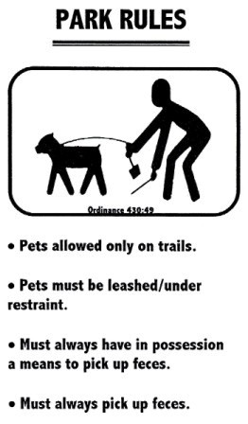
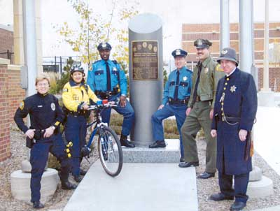
police policy

Slide 16

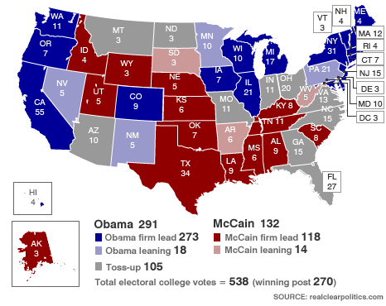
political

Slide 17
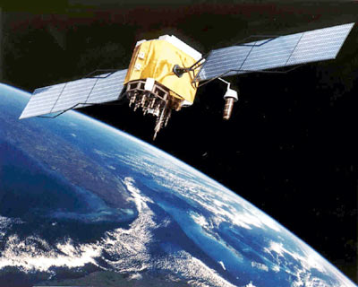
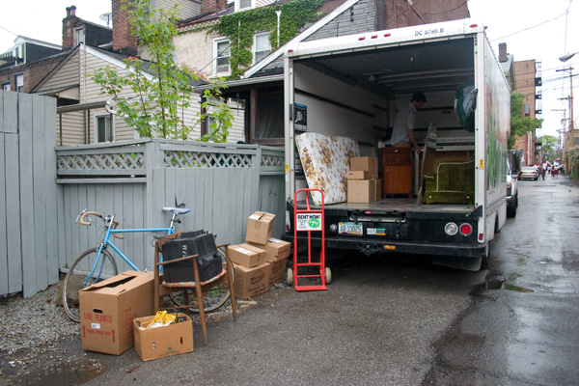
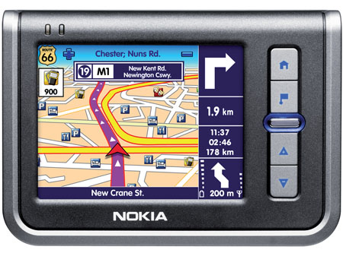
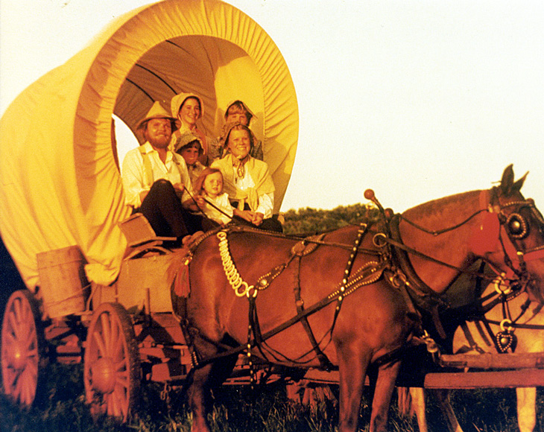
location relocate

Slide 18
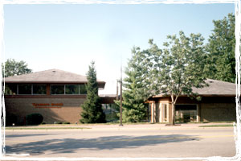
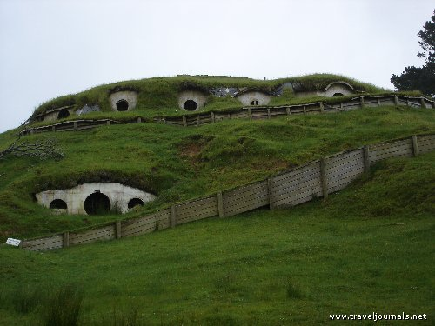
local locale
Blue Ash Library

Slide 19
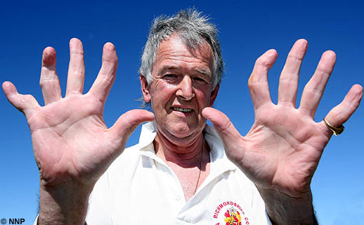
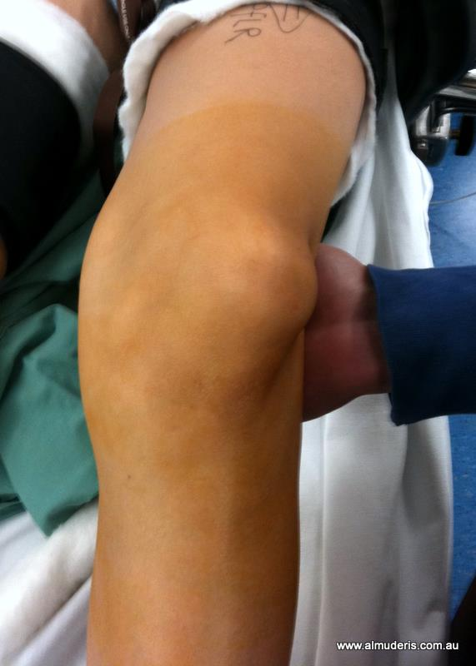
dislocate

Slide 20
Chapter Four – Good Living
Roots to Learn:
anim san
spir
Words to Learn
animate perspire
animosity conspire
animal sanitary
respiration sane
inspire sanitation
spirit
Prefix: Suffix:
in- -ary

Slide 21
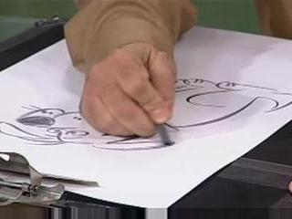
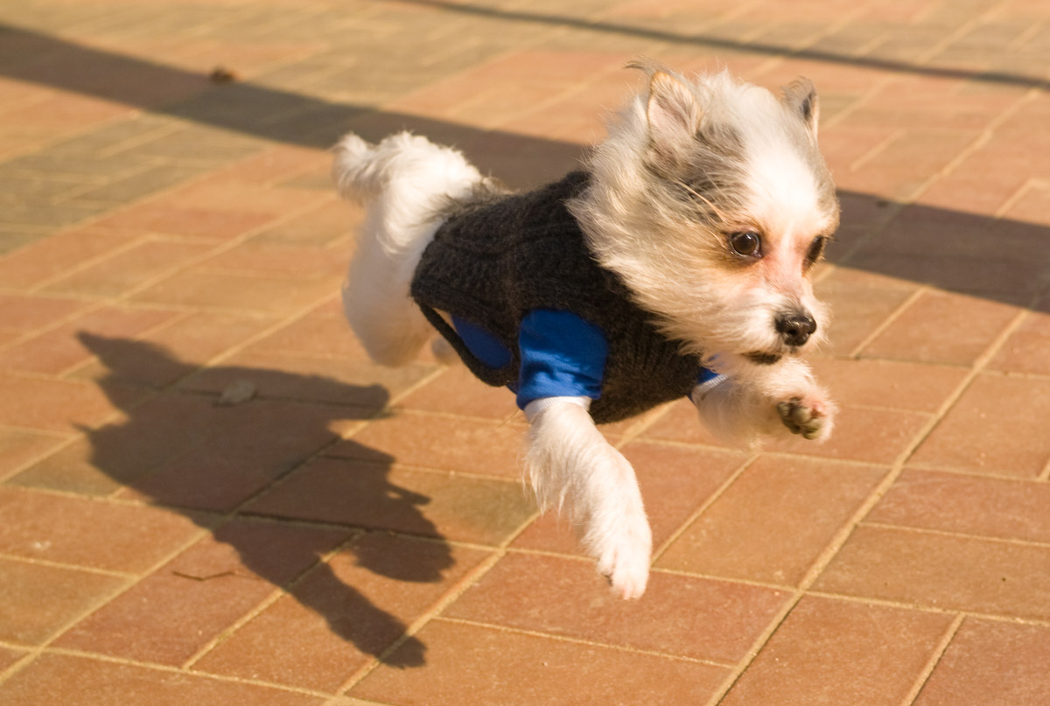
animate animate
(verb) (adjective)

Slide 22
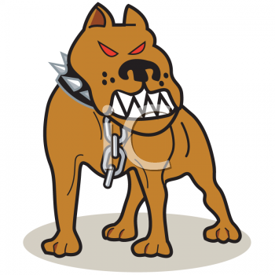
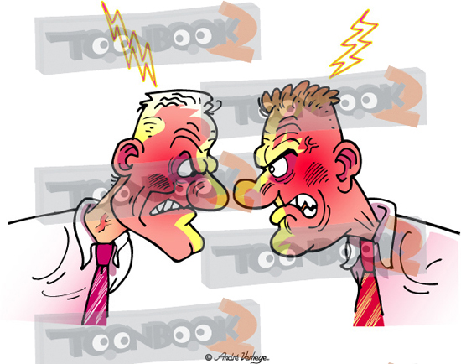
animosity

Slide 23
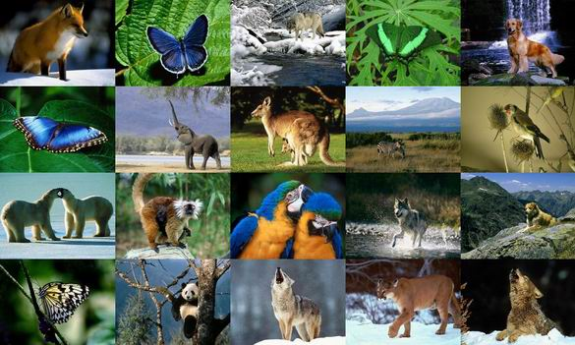
animal

Slide 24
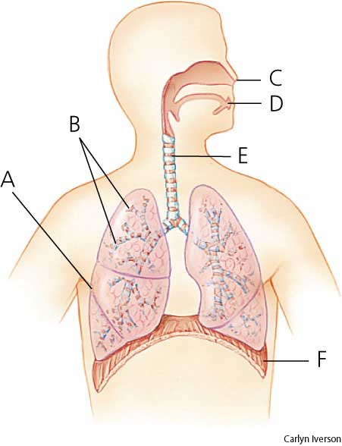
respiration

Slide 25
inspire spirit

